Slide 1

Export and Import of food
Presented by: CHEA Bunlong
Date: 22 /02 /2022

Slide 2
01
02
03
04
05
06
Table of contents
Database Introduction
Main Table and Primary Key
Analysis Process and Question
Key Insight
Conclusion
Reflection

Slide 3
01
Database Introduction

Slide 4
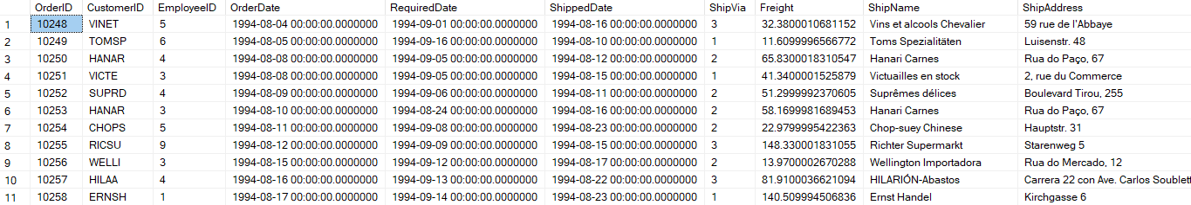
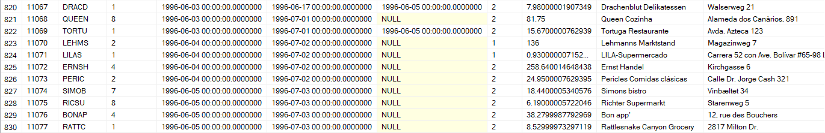
“This is the ‘Order and Supply Information’ data from Food Export and Import company that report from 1994 to 1996 ”

Slide 5

8 Table Entities
Categories
Shippers
Orders
4 Attributes
8 records
3 Attributes
3 records
14 Attributes
830 records
Customers
Suppliers
13 Attributes
93 records
12 Attributes
29 records
OrderDetail
Employees
Products
5 Attributes
2155 records
17 Attributes
9 records
10 Attributes
77 records

Slide 6
02
Main Table and Primary Key

Slide 7

Main Table
Customers
Shippers
Suppliers
Others

Slide 8
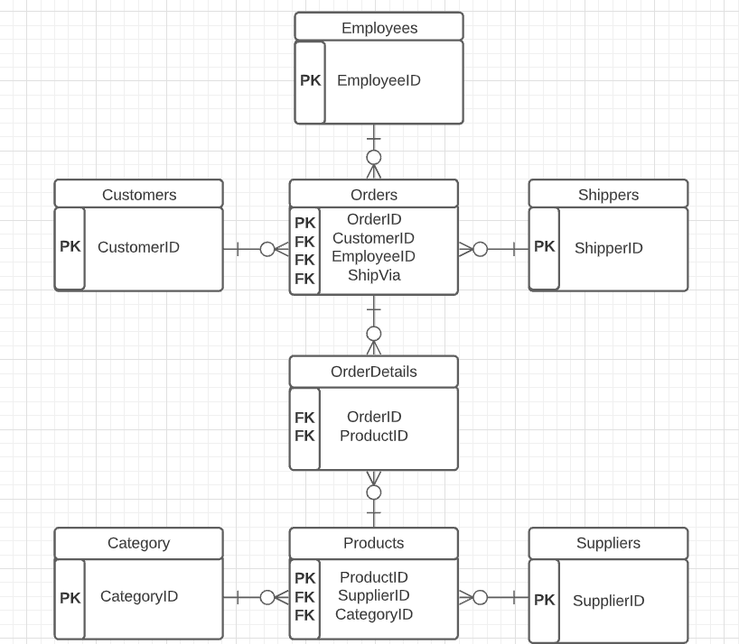
Primary and Foreign Key

Slide 9
03
Analysis Process and Question

Slide 10

Analysis Process
Import the Database into SQL Server
Clean each data to find null and duplicate by querying SQL
Find the Key and Relationship between table
Query SQL to find insight
Build Visualization on Google Sheet and Present on Google Slide

Slide 11
Question
Customers
Which countries that have the most company customers?
What are the overall Orders in each country?
What are the Total Price of orders in each country?
Shippers
What are the company that has the most shipment?
Supplier
What are the country that supply the most?

Slide 12
04
Key Insight

Slide 13
Which countries that have the most company customers?

Slide 14
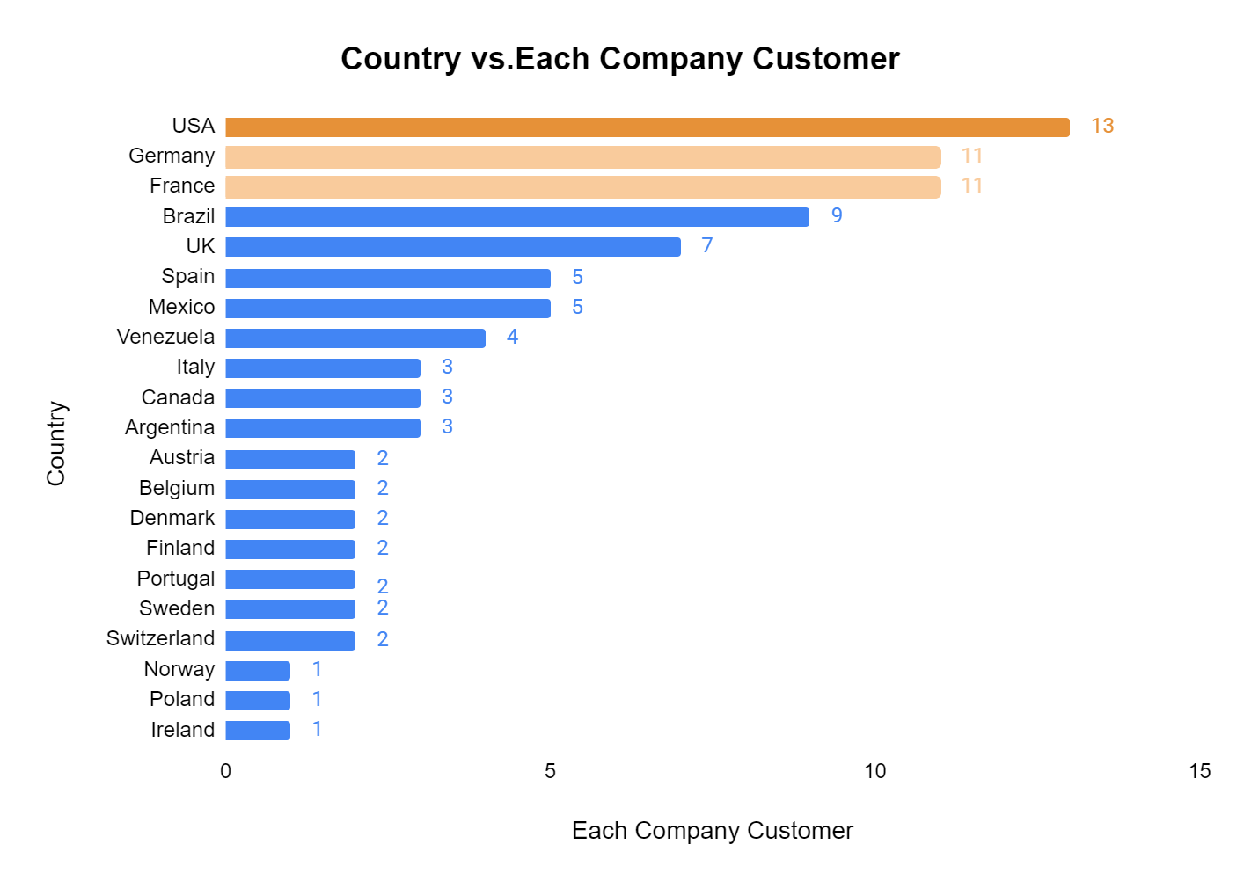
USA has the most customer of the company (13), followed by France and Germany (11).

Slide 15
What are the overall Orders in each country?
To find the overall Order in each country, then each city from the country that has the highest order

Slide 16
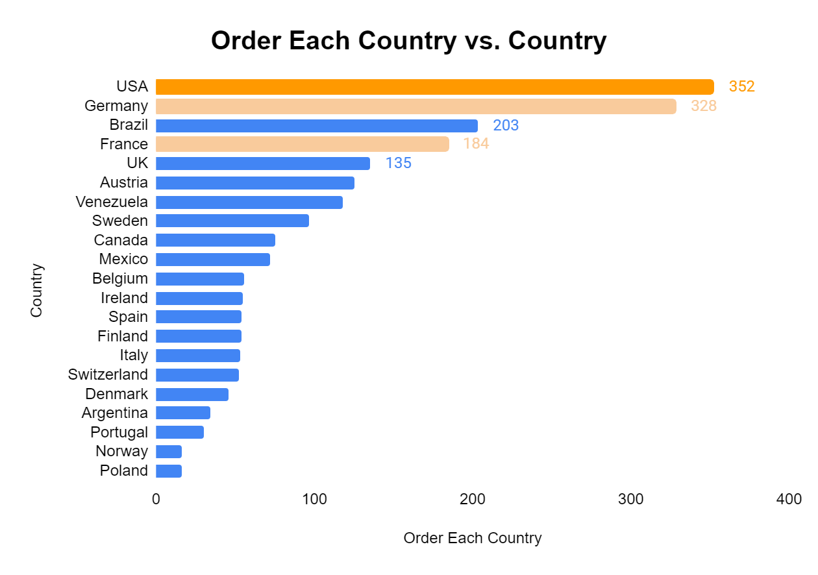
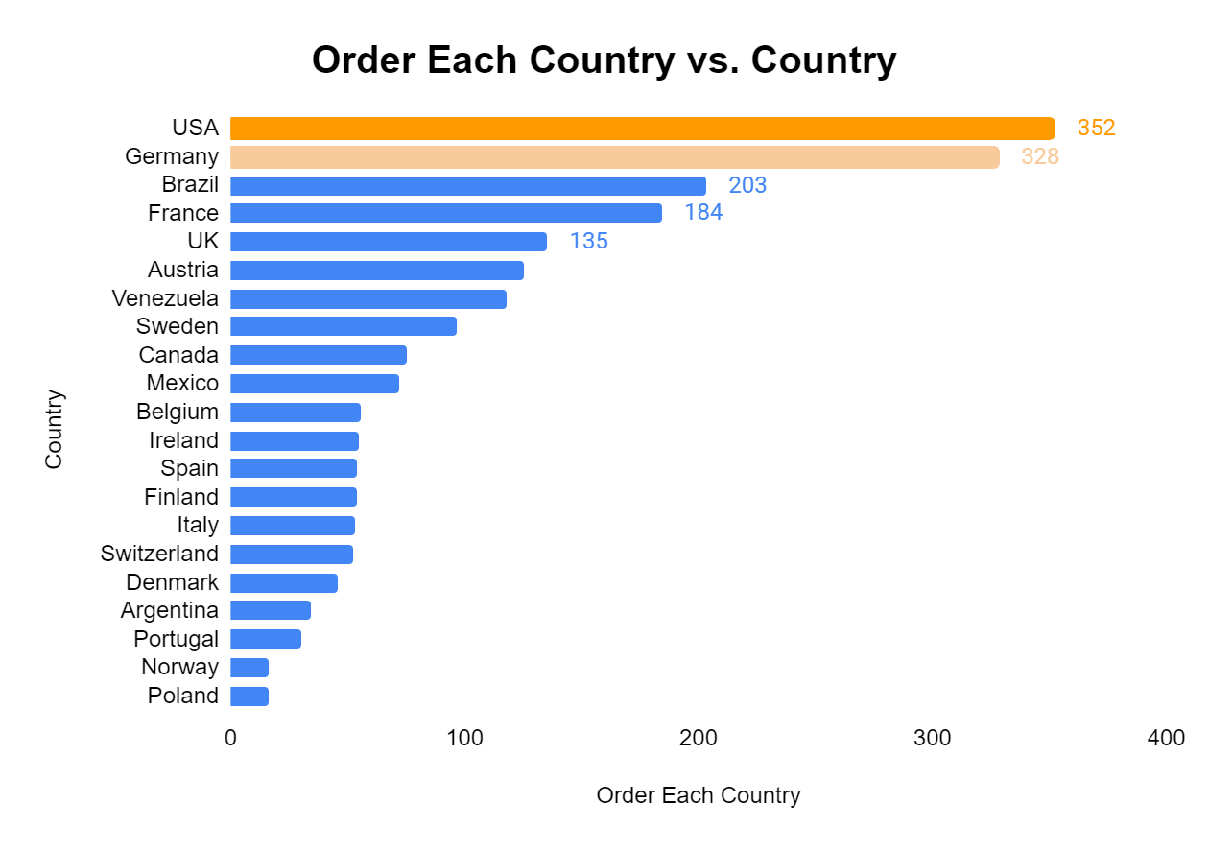
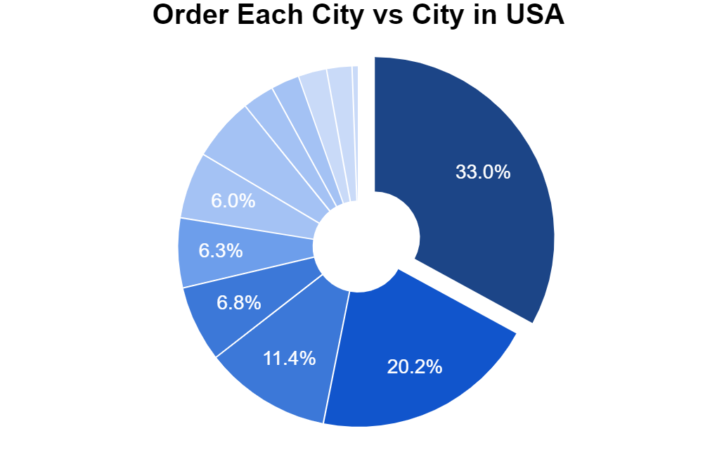
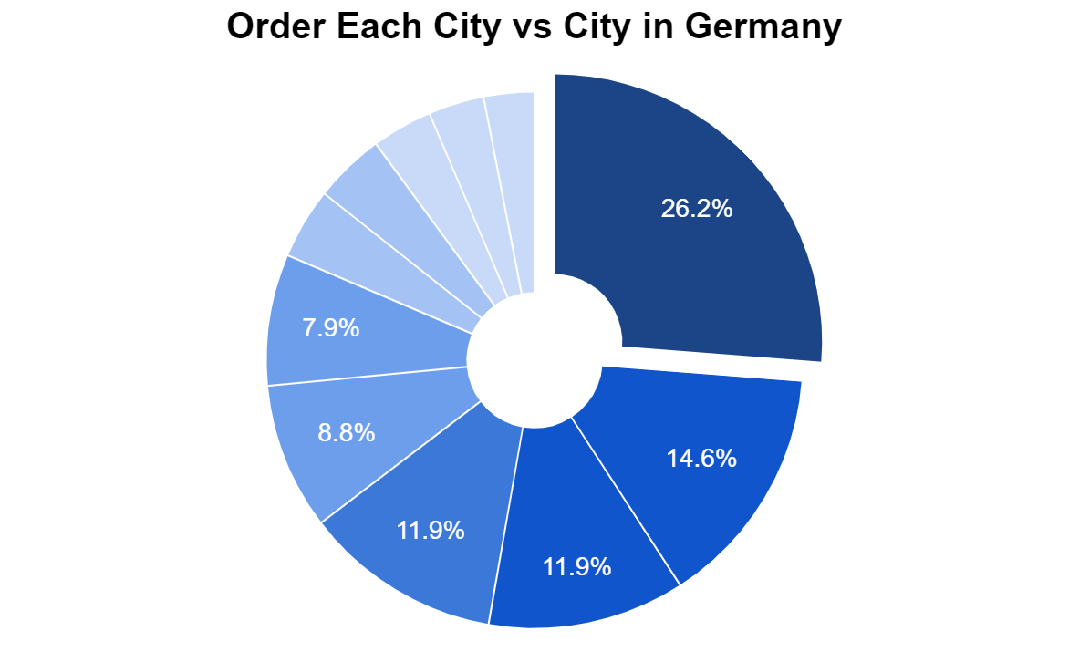
USA also has the most orders, followed by Germany
Brazil make more orders than France, despite many customers from France
Others
Lander
5.7%
Boise
Portland
Eugene
Anchorage
Albuquerque
Seattle
Others
Cunewalde
Stuttgart
Köln
München
Brandenburg
Frankfurt a.M.

Slide 17
What are the Total Price of orders in each country?
To find the Total Price of order in each country, and investigate the reason

Slide 18
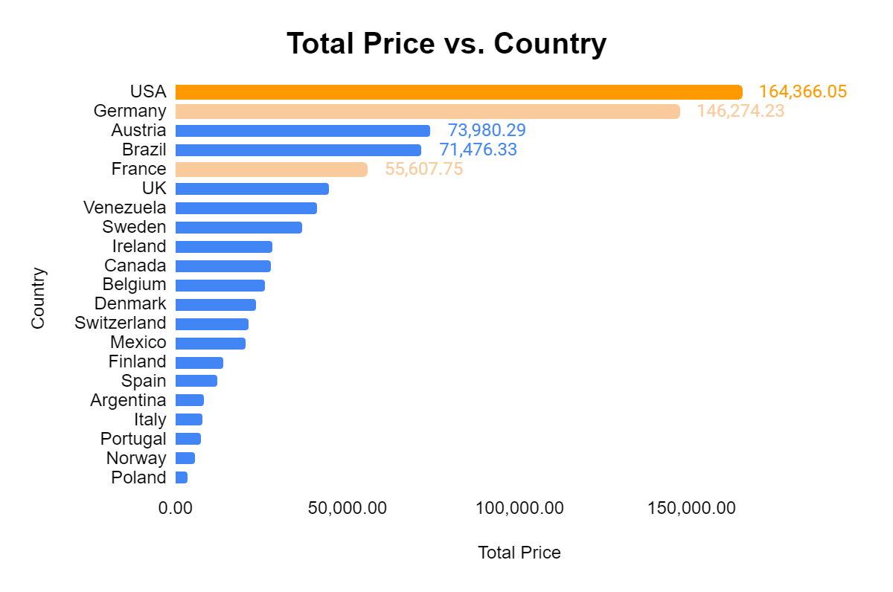
Austria has more total-price than Brazil & France
WHY?

Slide 19
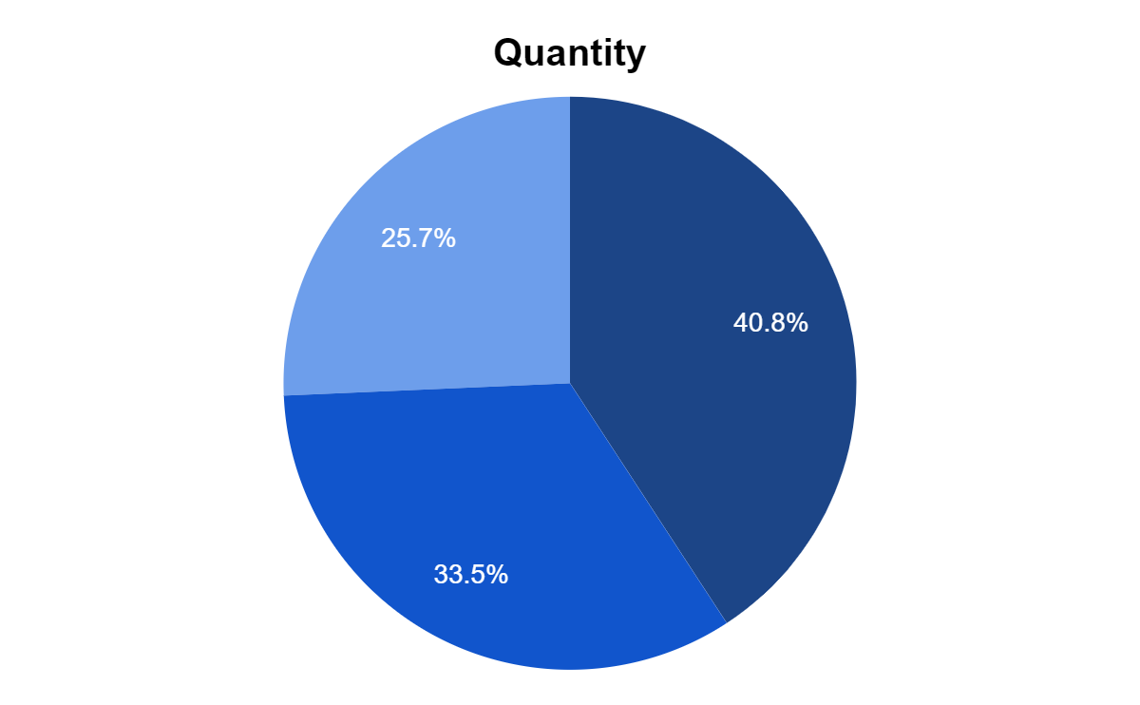
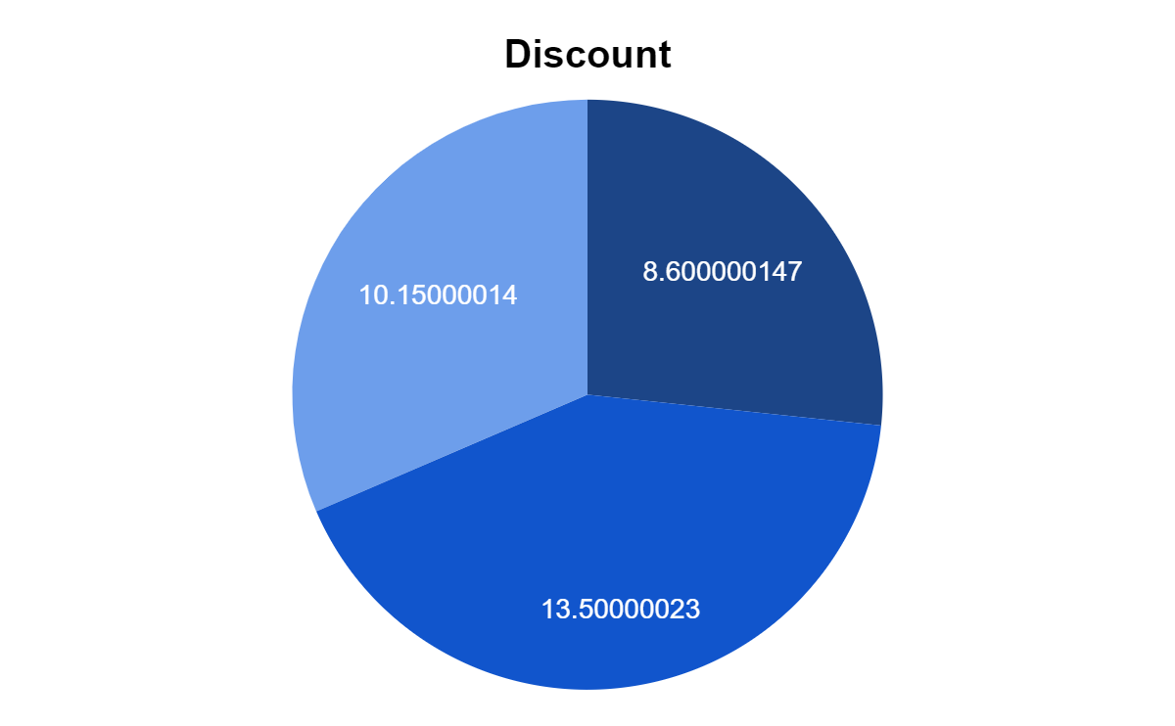
Austria order more quantity than France & Brazil, while having less discount than other two
France
Austria
Austria
France
Brazil
Brazil

Slide 20
What are the company that has the most shipment?
To find the Total Number of Shipment as the whole and learn which of these shipment companies that each country prefer the most

Slide 21
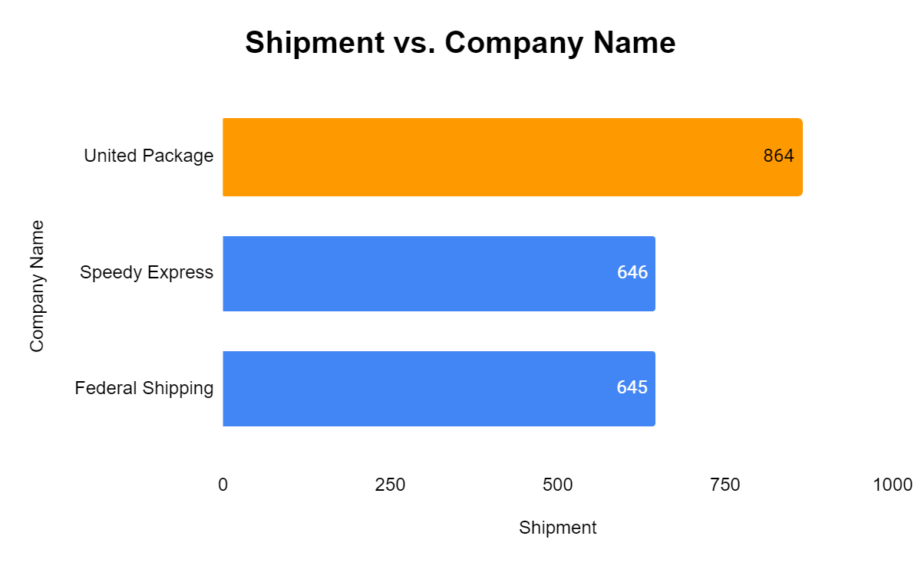
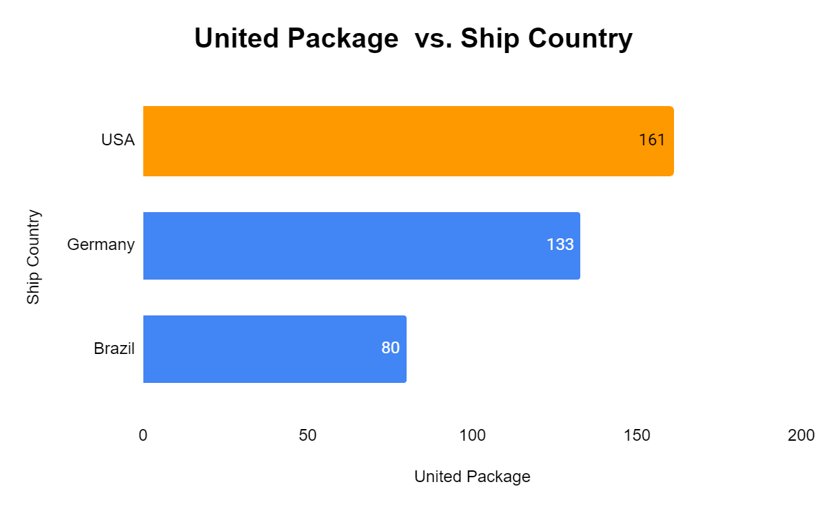
Most customers choose United Package company as their shipment.
However, different country prefer different shipment company:
United Package: USA

Slide 22
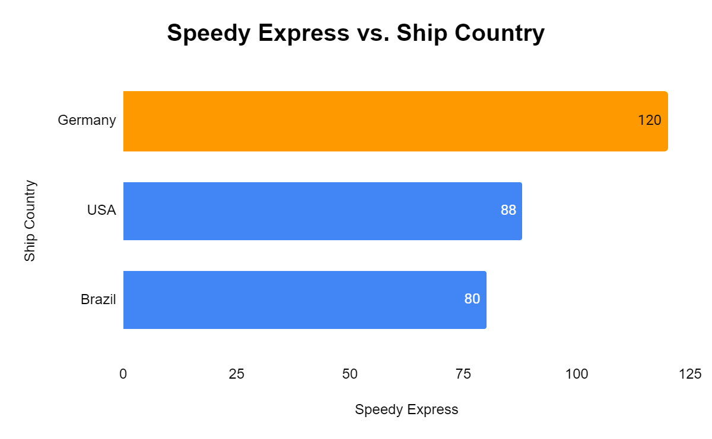
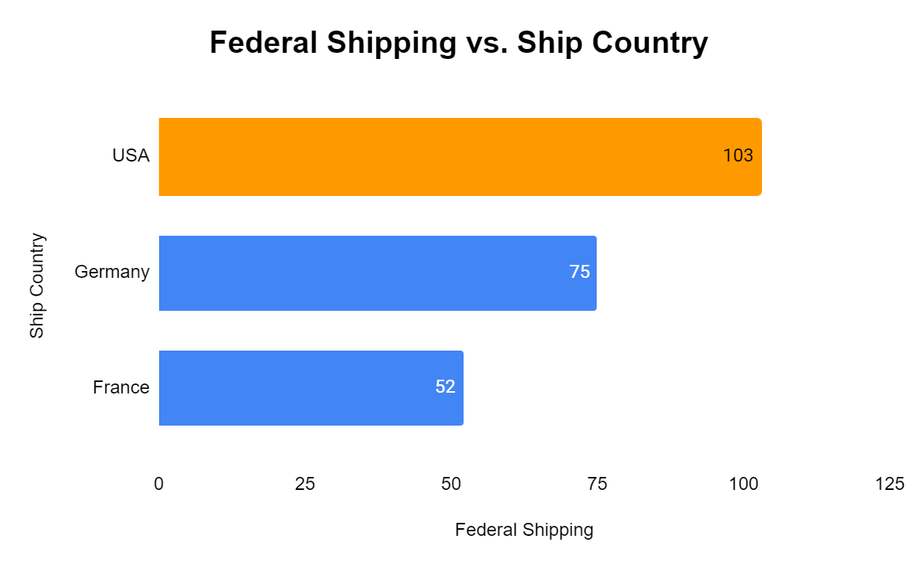
However, different country prefer different shipment company:
Speedy Express: Germany
Federal Shipping: USA

Slide 23
What are the country that supply the most?
To find the Number of Supply and Total Sales of order in each country

Slide 24
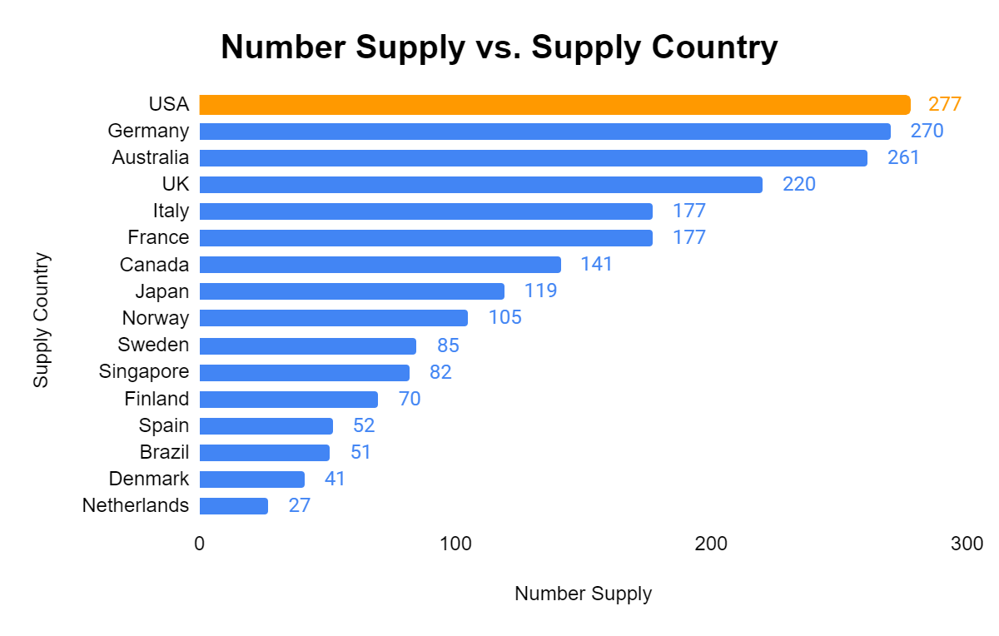
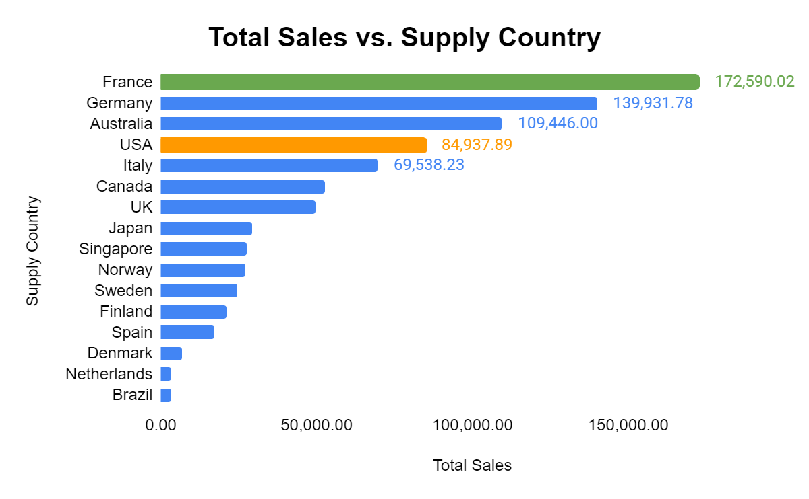
USA has the highest number of supply to customers
However, when come to Total Sales of exporting supply, France has the highest sold compare to USA
WHY?

Slide 25
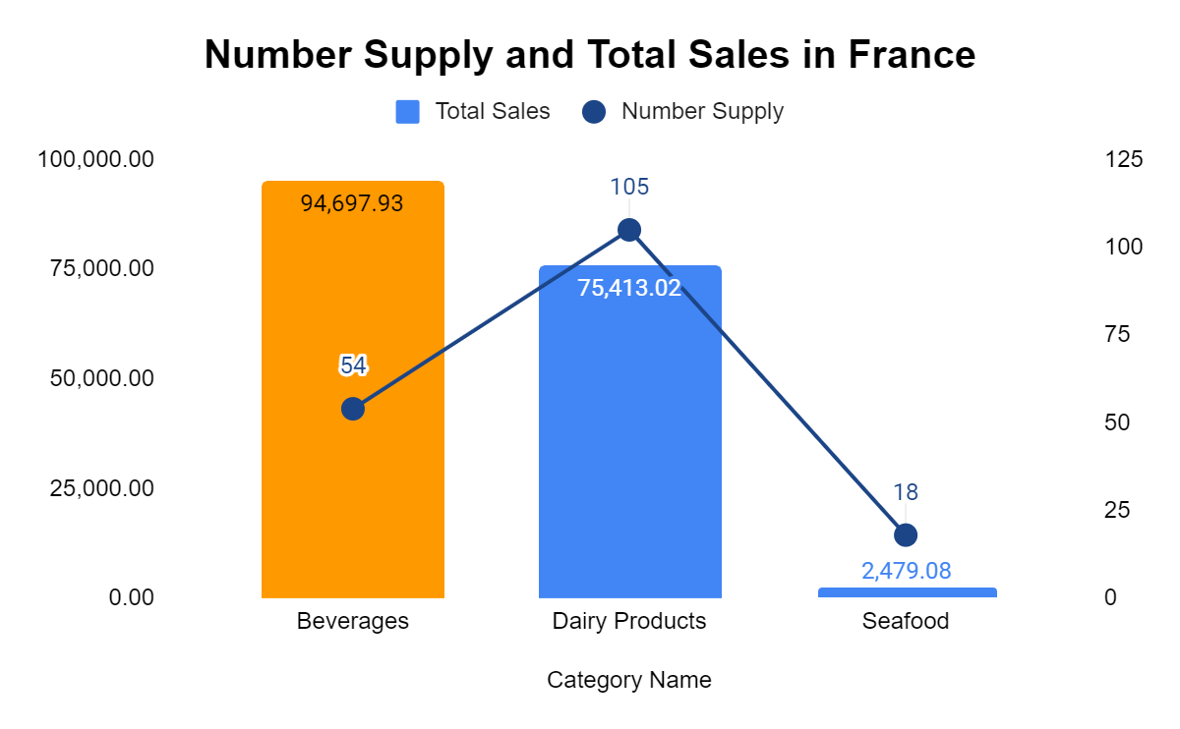
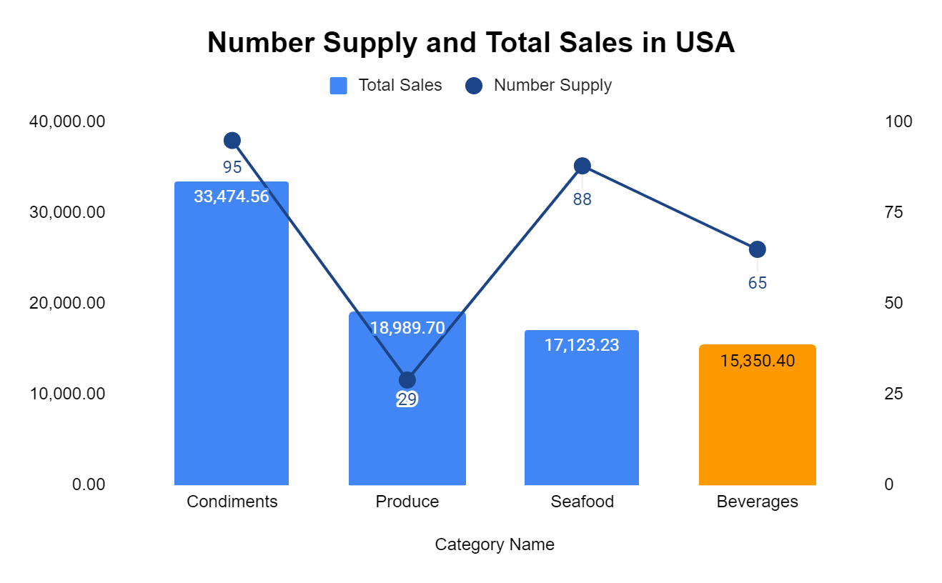
France has the highest sold in Beverage compare to USA

Slide 26
05
Conclusion

Slide 27
Conclusion
Total Order from country in each country | Asides from USA, France has the lower Total Order than Brazil and lower Total Price than Austria and Brazil. The reason is the higher quantity and lower total discount in Austria compare to France with lower quantity and higher total discount.
Number of shipment in each country | USA mostly prefer to use United Package & Federal Shipping, while Germany prefer Speedy Express.
Number of exporting supply and total exporting sales | Despite the highest amount of supply in USA, France has the highest sold due to higher price of Beverage compare to USA.

Slide 28
06
Reflection

Slide 29
THANK YOU
For your attention

